Slide 1


Slide 2

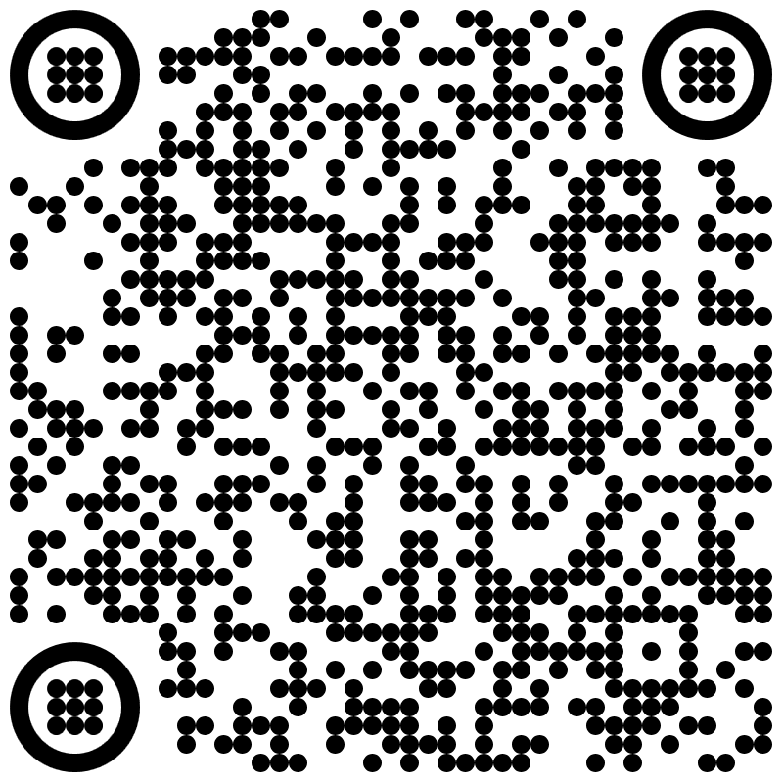
SIERRA VISTA 1st CHURCH OF GOD IN CHRIST’s GIVING OPPORTUNITIES
Scan QR code to donate
-or-
Mail checks or money orders to 2160 E. Fry Blvd, PMB 326, Sierra Vista, Az 85635.

Slide 3


Slide 4

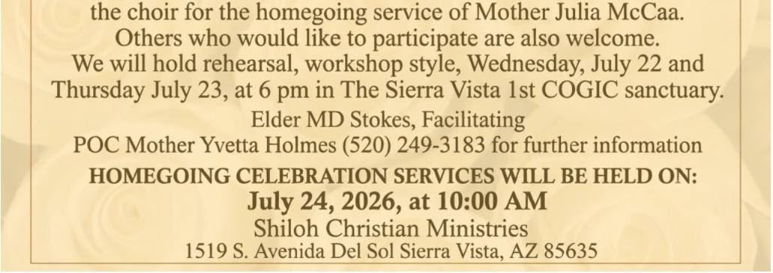

Slide 5


Slide 6


Slide 7
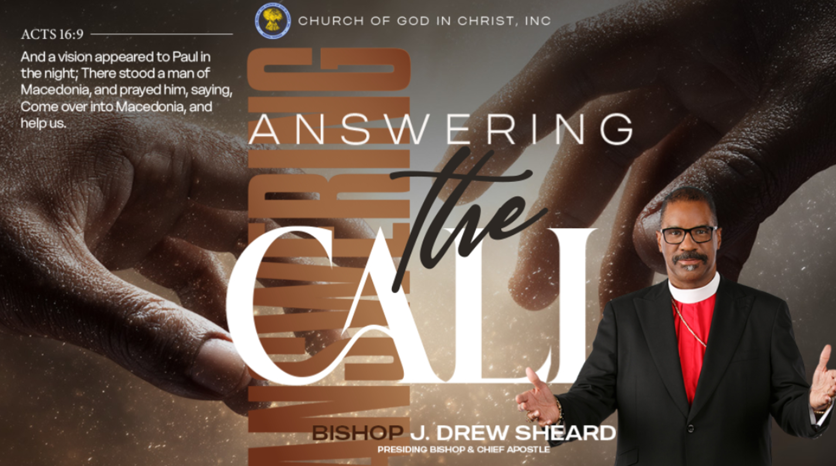

Slide 8
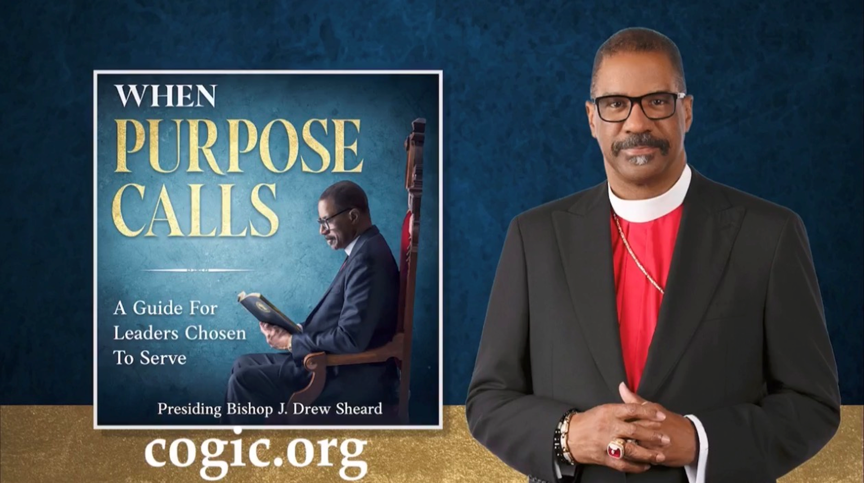

Slide 9
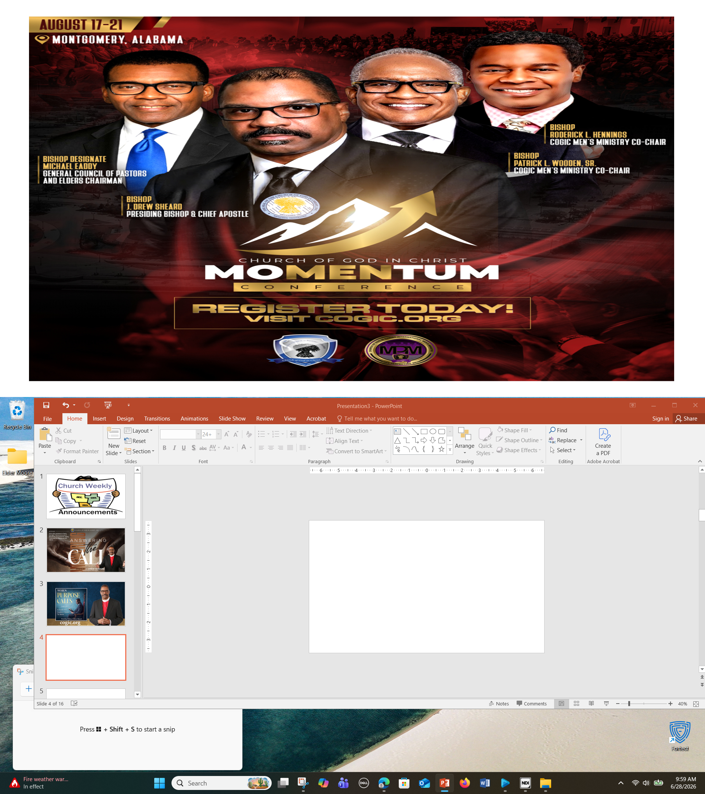

Slide 10
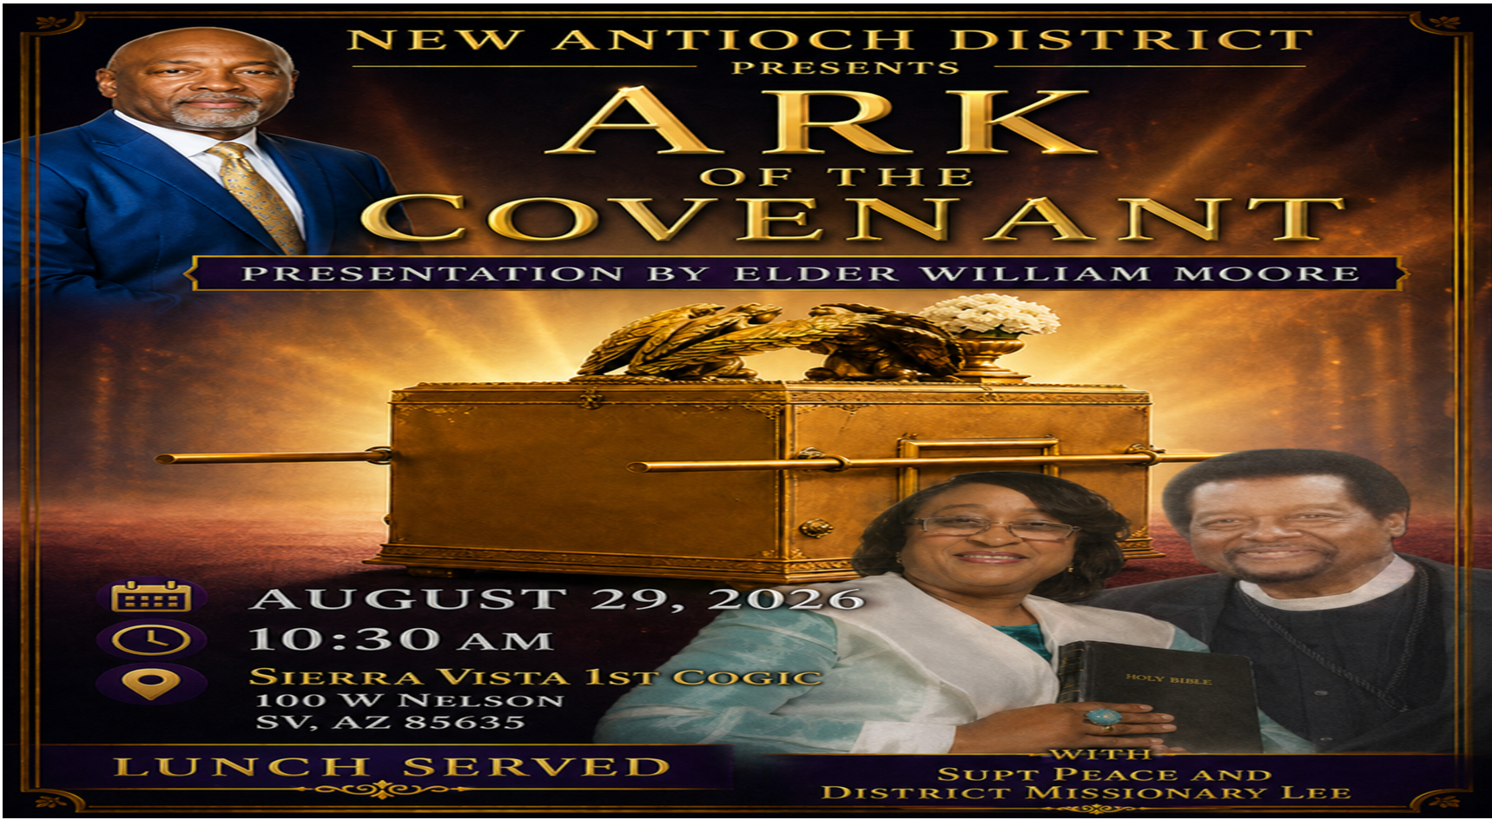

Slide 11


Slide 12
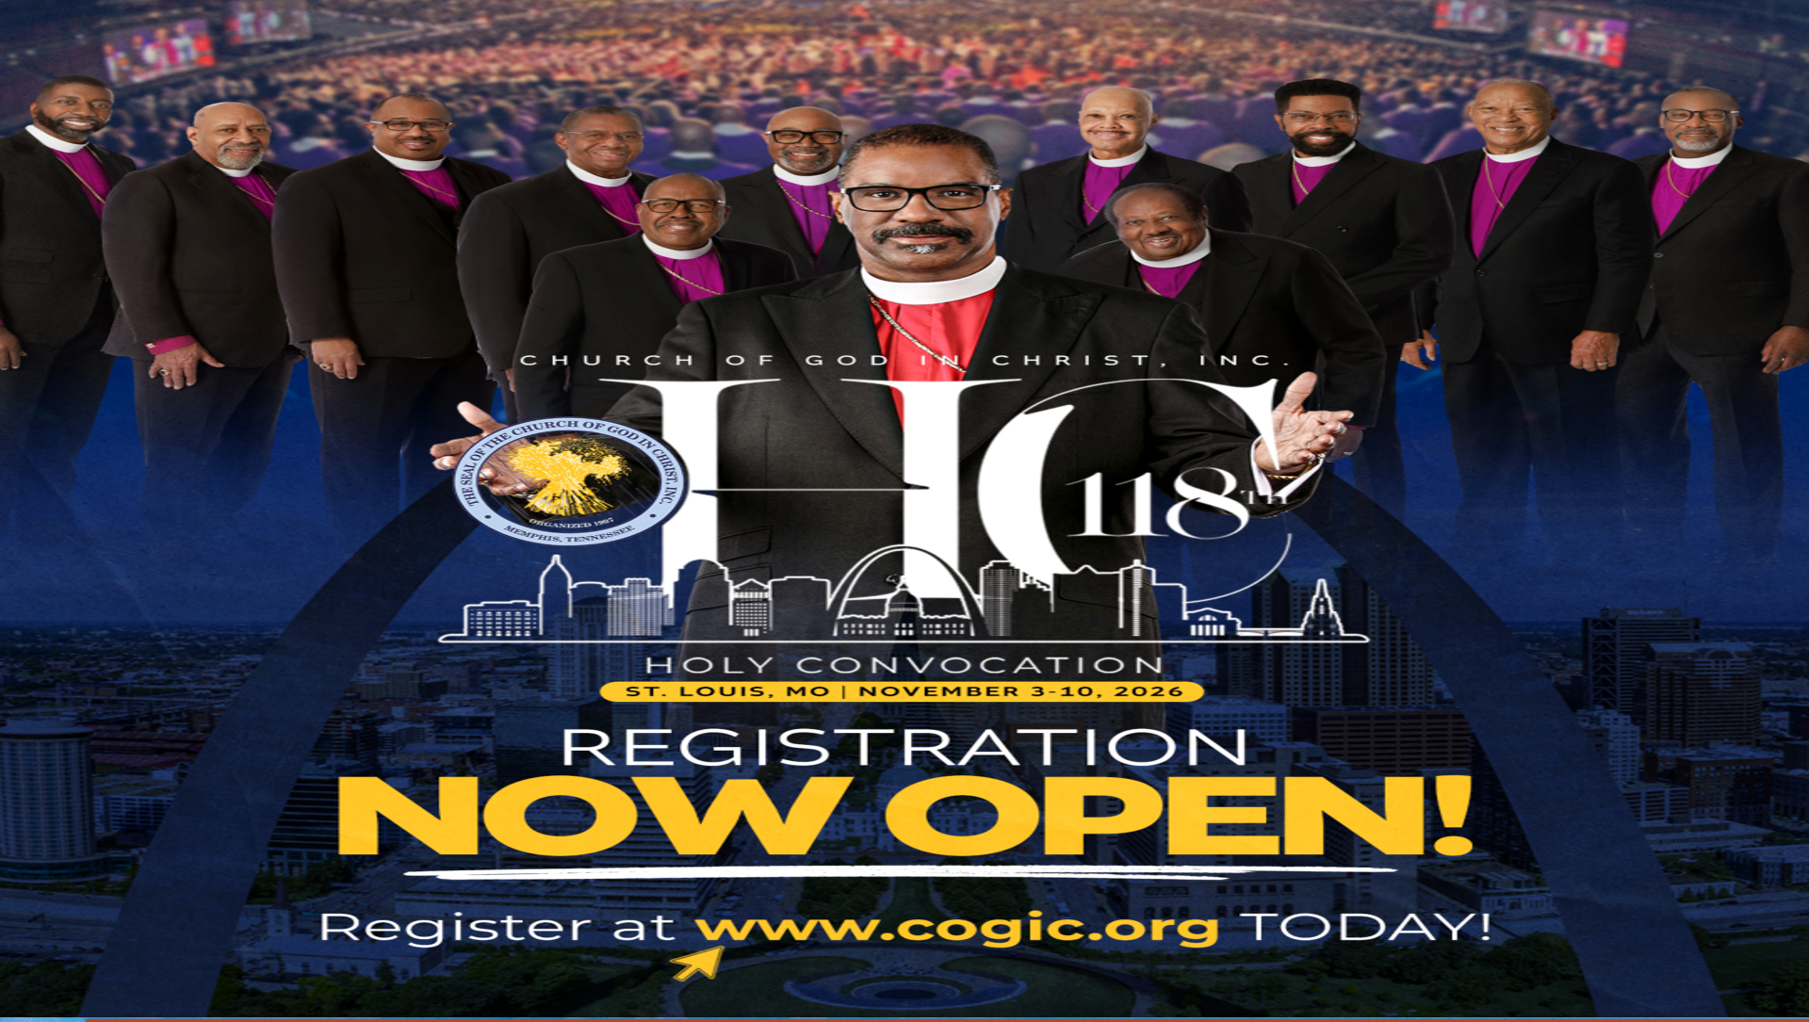
03-10 NOV 2026

Slide 13


Slide 14


Slide 15
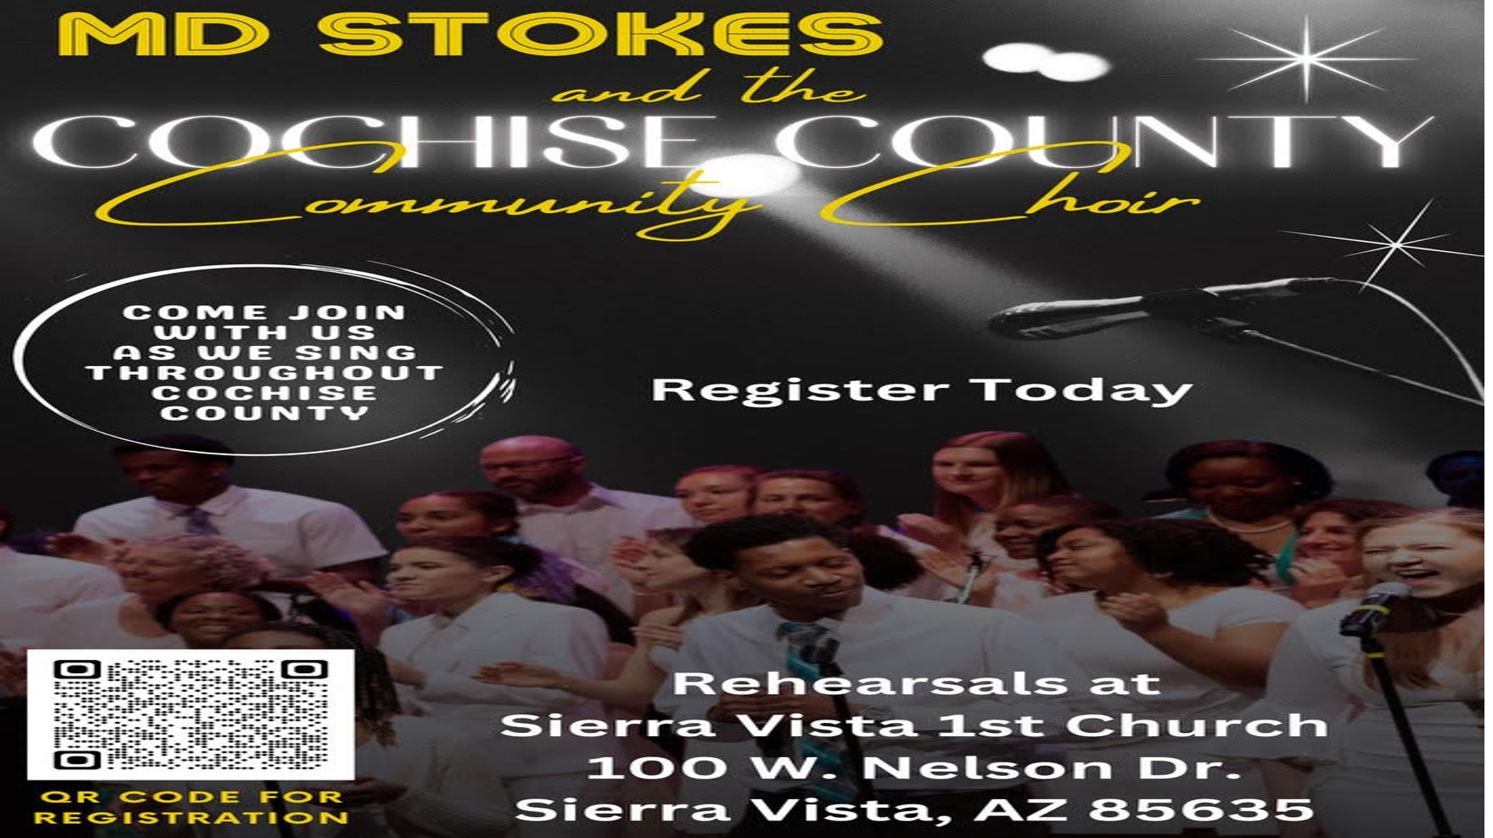

Slide 16
